Slide 1

Version Control

Slide 2
Topics covered
Disclaimer
Application to CS425
What is version control?
Why version control?
Version Control Models
Git Overview
Git Workflow
Git Tools
Contributing to Open Source
Questions/Comments

Slide 3
Disclaimer
This course will require the use of Git through GitHub
We can’t cover everything. Use tutorials to help answer questions.
Git tutorials and training
https://www.atlassian.com/git
https://www.coursera.org/learn/version-control-with-git
Many organizations offer training as part of employment
Notes:
Mention the possibility of using GitHub alternatives with teaching team approval

Slide 4
Why does this apply to CS425?
As a part of Project Part 3 deliverables, each team must have a functioning public repository on GitHub
Your database can be private (if your project has one)
Code under an NDA can be kept private
Add the public repository link to your P3 assignment. That’s it!
Please note that the teaching team will, if necessary, look at the activity in the repository to decide on certain aspects of grading
This task should take you only 10-20 minutes at most. If you require help, please attend one of our office hours and we will walk you through it.
Notes:
Mention that NDA code can be kept private

Slide 5
What is version control?
The process of tracking and managing changes to software source code
Also known as source control
Essentially, you’re storing your local changes to a remote repository
Do not store code on usb drives or Google Drive
Crucial to software teams
Contains loads of software tools that make cooperative programming much easier
Allows developers to essentially “undo” a mistake

Slide 6
Why version control?
Accountability
Who is contributing to the project?
Who is responsible for a check-in (broken code, not following best practices)
Ownership
Finding the creator of an old piece of code for help
Getting credit for your work, even years later
Deployment Pipelines
Have a stable release branch that is not used for development
Industry Practices
Version control history can be part of performance reviews
“Rolling back” to an old version of the code can help diagnose and fix errors

Slide 7
Why should you care?
Virtually all forms of employment use it
If they don’t use version control, make them use it or find employment elsewhere
It promotes a group dynamic
How else would you code with a group of 7+ people?
Everyone makes mistakes
Ever had a piece of code that was working, then it just didn’t?

Slide 8
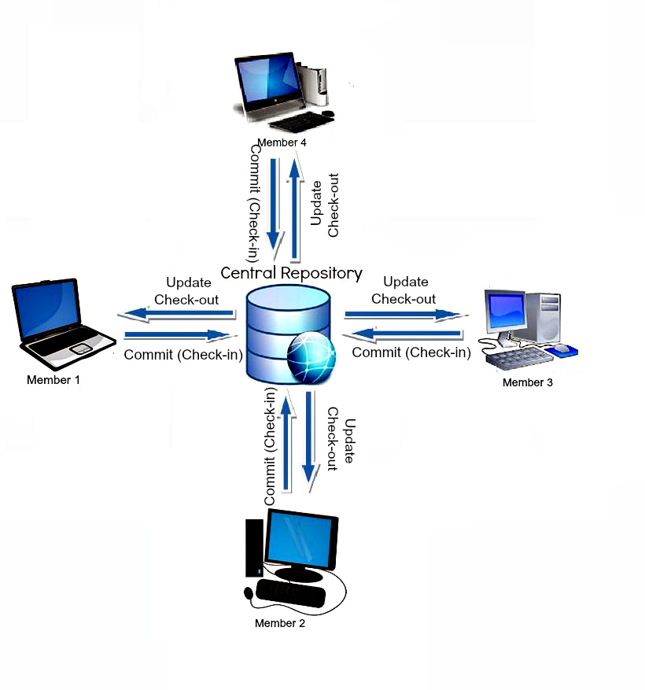
Version control models
Centralized Version Control System (CVCS)
The repository is held only on a central server
Code is checked into the central repository directly
Pros: More administrative powers & control over users and access, smaller local storage, easier to understand
Cons: Central point of failure, dependent on connection to central repository
Example: Perforce, StarTeam
Image Source: https://scmquest.com/centralized-vs-distributed-version-control-systems/

Slide 9
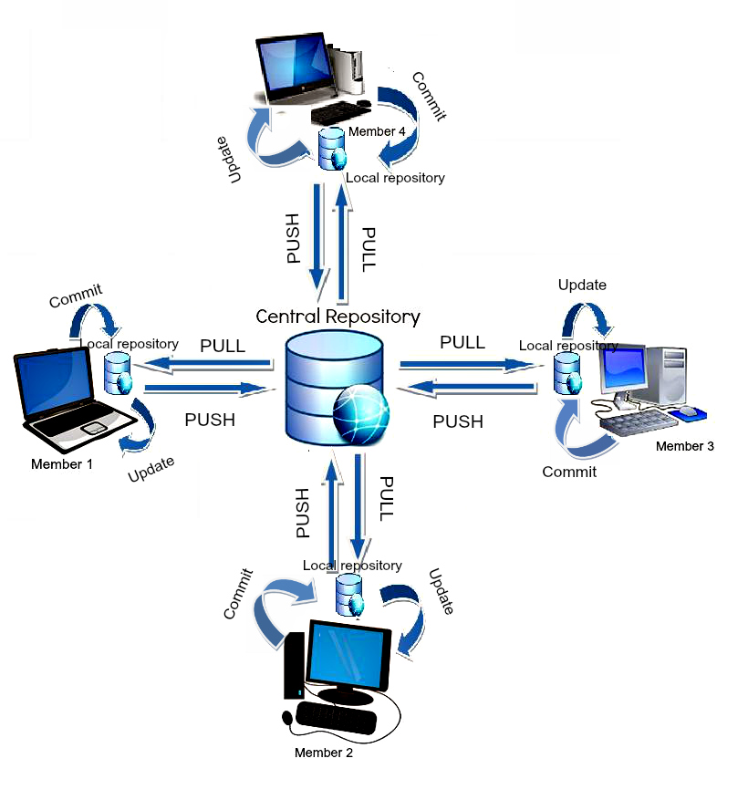
Version control models
Distributed Version Control System (DVCS)
The complete repository is mirrored on every developer’s system
Code is checked into the local repository then pushed to the central repository
Pros: Enables working offline, comparatively faster, every user has a repository backup
Cons: Higher storage requirements, proprietary code leaks more likely
Example: Git
Image Source: https://scmquest.com/centralized-vs-distributed-version-control-systems/

Slide 10
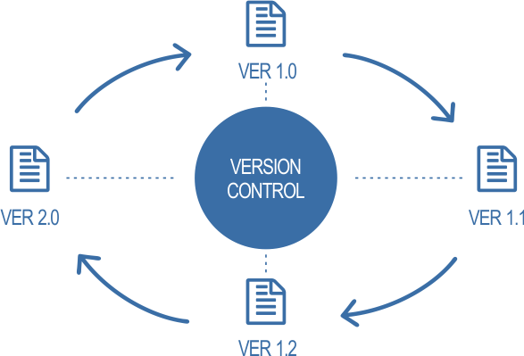
Git Overview: What is Git?
The most commonly used version control system in the world
It is the standard in which all version control systems follow
Team Foundation Server
Bitbucket
Apache Subversion
Git contains its own set of commands, much like linux commands
It can be a bit confusing at first, but it quickly becomes easier

Slide 11


Git Overview: Git vs GitHub
Git is the version control system itself
GitHub is a hosting service for Git repositories

Slide 12
Git Workflow: Check In & Check Out
Check In Code
git add
Adds a file to the staging area
git add -A
git status
git reset
git commit
Commit the changes in the staging area to the local repository with a message
git push
This action publishes your local repository to the remote repository (GitHub)
git push <remote> <branch>
Examples:
git push origin main
git push origin zach-dev
Check Out Code
git clone
Copy a repository to your local machine for the first time
git pull
Download remote repository
Update local repository to match remote repository
Examples:
git pull origin main
git pull origin zach-dev

Slide 13
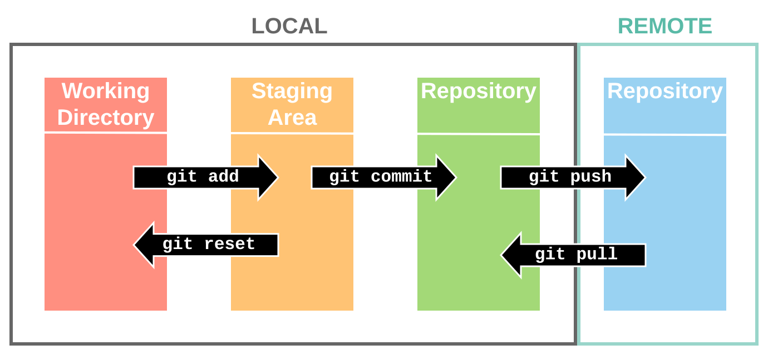
Git Workflow: Check In & Check Out

Slide 14
Git Workflow: Commit
“The body of your message should provide detailed answers to the following questions: What was the motivation for the change? How does it differ from the previous implementation?” - Github FAQ
The audience for your commit messages are developers looking to contribute to that repository
Bad Commit : git commit –m “Some changes”
Better Commit: git commit –m “Updated URI handlers”
Best Commit: git commit –m “Updated URI handlers” -m “Updated URI handlers for photo searching, thumbnail generation, and deployment data streams.”

Slide 15
Git Workflow: Branching
We are here
development
branch
main
We are here
git checkout -b “development branch”
checkout switches the currently active branch
-b argument creates the new branch “development branch”

Slide 16
Git Workflow: Branching Continued
development
branch
Commit
Head
main
Hotfix

Slide 17
Git Workflow: Merging
development
branch
We are here
We are here
main
git checkout main
This switches back to the main branch
git merge “development branch”
This merges “development branch” into the currently active main branch
Merges will automatically commit

Slide 18
Git Workflow: Handling Conflicts
development
branch
main
Sometimes we modify the same code in the same file
(You have probably run into this already)
git mergetool

Slide 19
Git Workflow: Git reset --hard
Commit
Head
Resets the branch back to the last commit
Dangerous on single branch
What happens if I reset with staged changes (but uncommitted)?

Slide 20
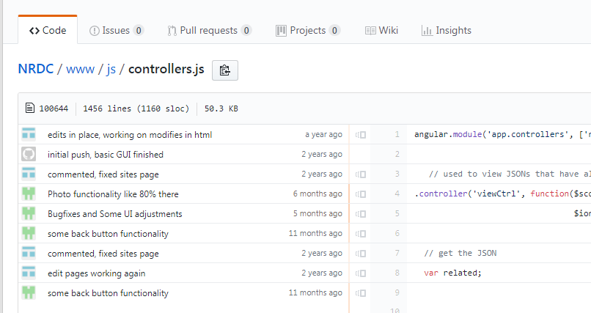
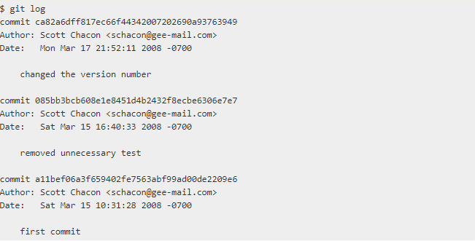
Git Workflow: Git History
git blame
Who’s doing what and where?
We can even see this on GitHub UI?
git log
Using this we can see the commit history
Using the commit names we can reset to a prior commit
git checkout <commit>

Slide 21
Git Tools
GitKraken
GUI application
https://www.gitkraken.com/
SourceTree
GUI application
https://www.sourcetreeapp.com/
TortoiseGit
Integrates with Windows Explorer as right-click options
https://tortoisegit.org/
Github Desktop
GUI Application
https://desktop.github.com/
Git Large File Storage
Git extension for versioning large files, such as videogame art
https://git-lfs.github.com/

Slide 22
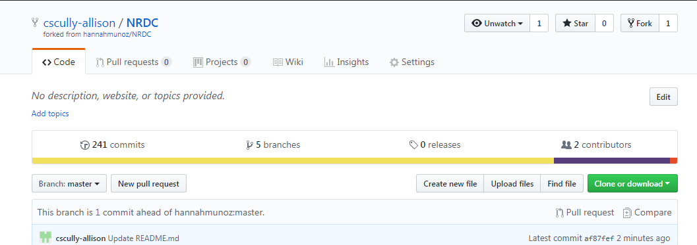
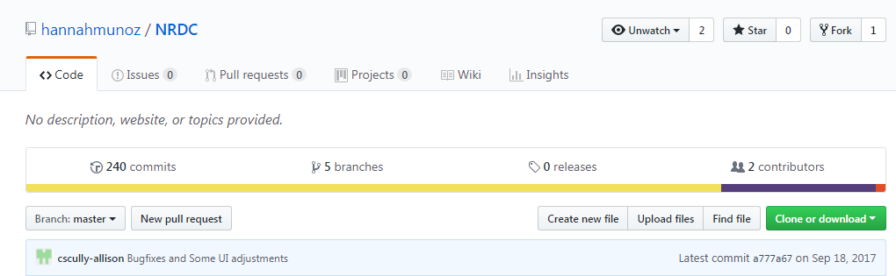
Contributing to Open Source
Forking a Repository
Modify and Pull Requests

Slide 23
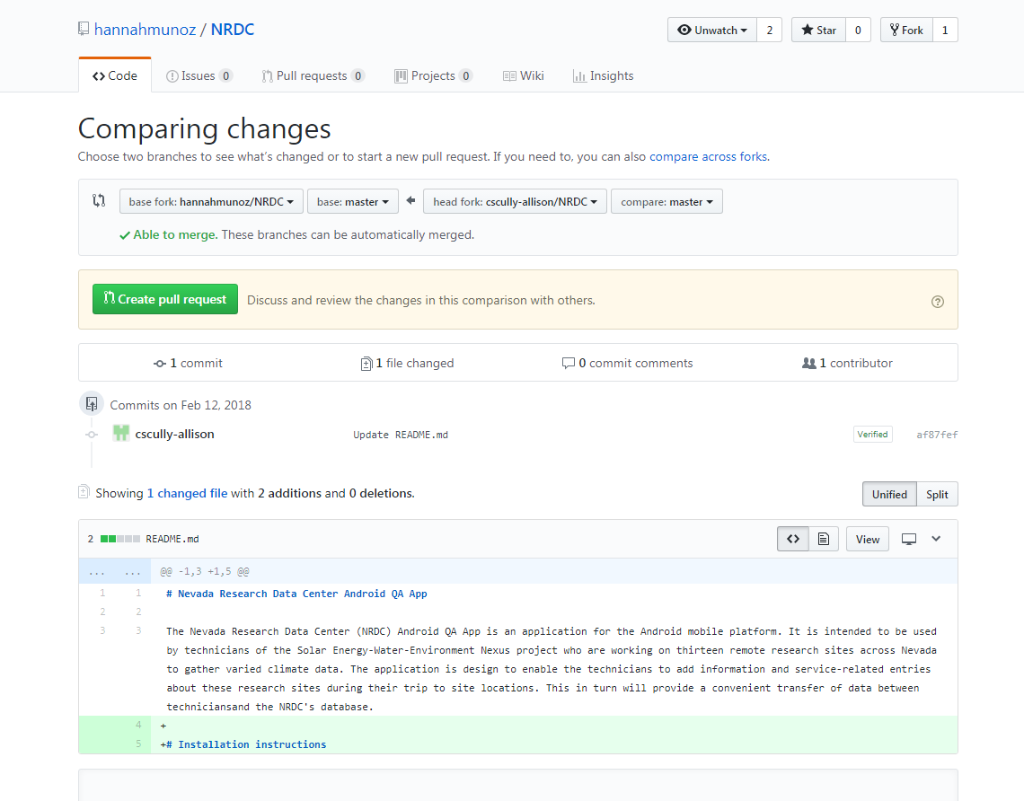
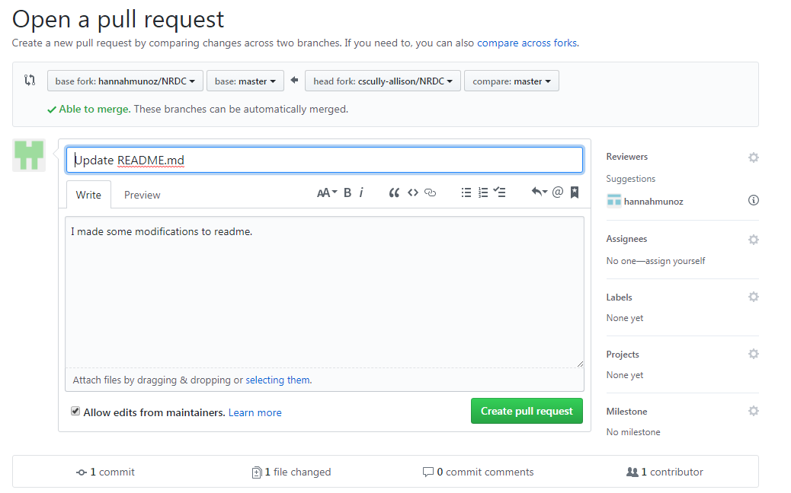

Slide 24
Questions?

